Slide 1


JAVA (Skill Based Lab)
MODULE 4: Inheritance
Prof Indu Anoop

Slide 2
What’s in this Module
1.INHERITANCE
1.1 INTRODUCTION
1.2 TYPES
1.3 MULTIPLE INHERITANCE USING INTERFACE
01
2. METHOD OVERRIDING
02
3.1 SUPER KEYWORD
3.2 ABSTRACT CLASS
3.3 ABSTRACT METHOD
03

Slide 3
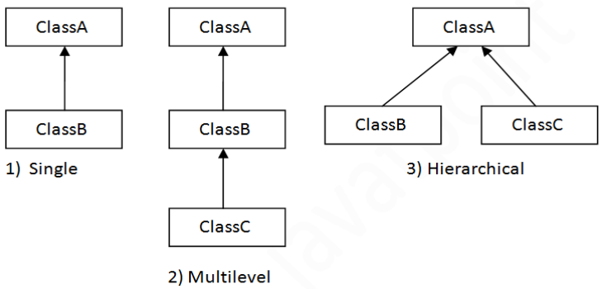
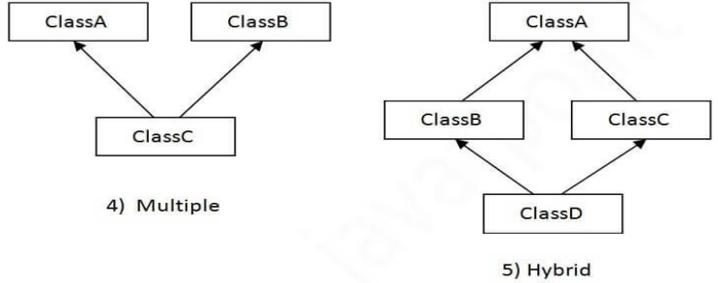
Inheritance
On the basis of class, there can be three types of inheritance in java: single, multilevel and hierarchical. In java programming, multiple and hybrid inheritance is supported through interface only. We will learn about interfaces later.

Slide 4
Let’s solve:
Exp8 : Program on Types of inheritance

Slide 5
Single Inheritance (Example)
class Animal {
void eat(){
System.out.println("eating...");
}
}
class Dog extends Animal {
void bark(){
System.out.println("barking...");
}
}
class TestSingleInheritance {
public static void main(String args[]) {
Dog d=new Dog();
d.bark();
d.eat();
}
}
Output: barking...
eating...

Slide 6
Multi-level Inheritance (Example)
class Animal {
void eat(){
System.out.println("eating...");
}
}
class Dog extends Animal {
void bark(){
System.out.println("barking...");
}
}
class BabyDog extends Dog {
void weep(){
System.out.println("weeping...");
}
}
class TestMultiLevelInheritance {
public static void main(String args[]) {
BabyDog d=new BabyDog();
d.weep();
d.bark();
d.eat();
}
}
Output: weeping... barking... eating..
Multilevel Inheritance Example When there is a chain of inheritance, it is known as multilevel inheritance. As you can see in the example given below, BabyDog class inherits the Dog class which again inherits the Animal class, so there is a multilevel inheritance.

Slide 7
Hierarchial Inheritance (Example)
class Animal {
void eat(){
System.out.println("eating...");
}
}
class Dog extends Animal {
void bark(){
System.out.println("barking...");
}
}
class Cat extends Animal {
void meow(){
System.out.println("meowing...");
}
}
class TestHeirarchialInheritance {
public static void main(String args[]) {
Cat c=new Cat();
c.meow();
c.eat();
//c.bark();//C.T.Error
}
}
Output: meowing... eating...
When two or more classes inherits a single class, it is known as hierarchical inheritance. In the example given below, Dog and Cat classes inherits the Animal class, so there is hierarchical inheritance.

Slide 8
Method Overriding
If subclass (child class) has the same method as declared in the parent class, it is known as method overriding in Java. In other words, If a subclass provides the specific implementation of the method that has been declared by one of its parent class, it is known as method overriding.
Method overriding is used for runtime polymorphism
Rules for Java Method Overriding
The method must have the same name as in the parent class
The method must have the same parameter as in the parent class

Slide 9
Method Overriding (Example)
Example:
class Vehicle {
void run() {
System.out.println("Vehicle is running");
}
}
//Creating a child class
class Bike2 extends Vehicle {
void run() {
System.out.println("Bike is running safely");
}
public static void main(String args[]) {
//creating object
Bike2 obj = new Bike2();
//calling method
obj.run();
}
}
Output: Bike is running safely

Slide 10
Super Keyword
The super keyword in Java is a reference variable which is used to refer immediate parent class object. Whenever you create the instance of subclass, an instance of parent class is created implicitly which is referred by super reference variable
Usage of Java super Keyword
super can be used to refer immediate parent class instance variable.
super can be used to invoke immediate parent class method.
super() can be used to invoke immediate parent class constructor

Slide 11
Super Keyword(Example1)
class Animal {
void eat(){
System.out.println("eating...");
}
}
class Dog extends Animal{
void eat(){
System.out.println("eating bread...");
}
void bark(){
System.out.println("barking...");
}
void work() {
super.eat();
bark();
}
}
class TestSuper2 {
public static void main(String args[]) {
Dog d=new Dog();
d.work();
}
}
super can be used to invoke parent class method The super keyword can also be used to invoke parent class method. It should be used if subclass contains the same method as parent class. In other words, it is used if method is overridden
Output: eating... barking...

Slide 12
Super Keyword(Example2)
class Animal {
Animal(){
System.out.println("animal is created");
}
}
class Dog extends Animal {
Dog(){
super();
System.out.println("dog is created");
}
}
class TestSuper3 {
public static void main(String args[]) {
Dog d=new Dog();
}
}
The super keyword can also be used to invoke the parent class constructor.
Output: animal is created
dog is created

Slide 13
Abstract Class and Methods
If you want a class to contain a particular method but you want the actual implementation of that method to be determined by child classes, you can declare the method in the parent class as an abstract.
abstract keyword is used to declare the method as abstract.
You have to place the abstract keyword before the method name in the method declaration.
An abstract method contains a method signature, but no method body.
Instead of curly braces, an abstract method will have a semi colon (;) at the end.
public abstract class Employee {
private String name;
private String address;
private int number;
public abstract double computePay();
// Remainder of class definition
}
Declaring a method as abstract has two consequences −
The class containing it must be declared as abstract.
Any class inheriting the current class must either override the abstract method or declare itself as abstract.

Slide 14
Abstract Class and Methods (Example)
abstract class Bike {
abstract void run();
}
class Honda4 extends Bike {
void run(){
System.out.println("running safely");
}
public static void main(String args[]) {
Bike obj = new Honda4();
obj.run();
}
}
Declaring a method as abstract has two consequences −
The class containing it must be declared as abstract.
Any class inheriting the current class must either override the abstract method or declare itself as abstract.
Output: running safely

Slide 15
final Keyword
The final keyword in java is used to restrict the user. The java final keyword can be used in many context. Final can be: o variable o method o class The final keyword can be applied with the variables, a final variable that have no value it is called blank final variable or uninitialized final variable. It can be initialized in the constructor only. The blank final variable can be static also which will be initialized in the static block only
Java final variable If you make any variable as final, you cannot change the value of final variable(It will be constant).
Example:
class Bike9 {
final int speedlimit=90;//final variable
void run(){
speedlimit=400;
}
public static void main(String args[]) {
Bike9 obj=new Bike9();
obj.run();
}
}//end of class
Output: Compile Time Error

Slide 16
final Keyword
2) Java final method If you make any method as final, you cannot override it.
Example:
class Bike {
final void run(){
System.out.println("running");
}
}
class Honda extends Bike {
void run(){
System.out.println("running safely with 100kmph");
}
public static void main(String args[]) {
Honda honda= new Honda();
honda.run();
}
}
Output: Compile Time Error

Slide 17
final Keyword
3) Java final class If you make any class as final, you cannot extend it.
Example:
final class Bike{}
class Honda1 extends Bike {
void run(){
System.out.println("running safely with 100kmph");
}
public static void main(String args[]) {
Honda1 honda= new Honda1();
honda.run();
}
}
Output: Compile Time Error

Slide 18
Interface
An interface is a completely "abstract class" that is used to group related methods with empty bodies
Example:
// interface
interface Animal {
public void animalSound(); // interface method (does not have a body)
public void run(); // interface method (does not have a body)
}
To access the interface methods, the interface must be "implemented" (kinda like inherited) by another class with the implements keyword (instead of extends). The body of the interface method is provided by the "implement" class

Slide 19
Interface Example
Example: // Interface
interface Animal {
public void animalSound(); // interface method (does not have a body)
public void sleep(); // interface method (does not have a body)
}
// Pig "implements" the Animal interface
class Pig implements Animal {
public void animalSound() {
// The body of animalSound() is provided here
System.out.println("The pig says: wee wee");
}
public void sleep() { // The body of sleep() is provided here
System.out.println("Zzz");
}
}
class MyMainClass {
public static void main(String[] args) {
Pig myPig = new Pig(); // Create a Pig object
myPig.animalSound();
myPig.sleep();
}
}
Notes on Interfaces:
Like abstract classes, interfaces cannot be used to create objects (in the example above, it is not possible to create an "Animal" object in the MyMainClass)
Interface methods do not have a body - the body is provided by the "implement" class
On implementation of an interface, you must override all of its methods
Interface methods are by default abstract and public
Interface attributes are by default public, static and final
An interface cannot contain a constructor (as it cannot be used to create objects)

Slide 20
Exp9 : Let’s solve Program on Multiple Inheritance

Slide 21
interface AnimalEat {
void eat();
}
interface AnimalTravel {
void travel();
}
class Animal implements AnimalEat,AnimalTravel {
public void eat() {
System.out.println("Animal is eating");
}
public void travel() {
System.out.println("Animal is travelling");
}
}
public class MultipleInheritaceDemoUsingInterfaces {
public static void main(String args[]) {
Animal a = new Animal();
a.eat();
a.travel();
}
}

